Slide 1

First International Conference on Emerging Technologies in Science and Engineering ICETSE 2024 26th and 27th June 2024 Paper Id: ICETSE-2024_122 Paper Title: Parallelization of Pigeonhole Sort for Efficient Data Sorting Pasupuleti Rohith Sai Datta, Chinmaya D Kamath, N Gopalakrishna Kini, Ashwath Rao B Department of Computer Science and Engineering Manipal Institute of Technology, Manipal Academy of Higher Education, Manipal, INDIA

Slide 2
PRESENTATION OVERVIEW
International Conference on Emerging Technologies in Science and Engineering
INTRODUCTION
OBJECTIVE
METHODOLOGY
RESULT
CONCLUSION
REFERENCES
AIT, TUMAKURU

Slide 3
INTRODUCTION
International Conference on Emerging Technologies in Science and Engineering
As data grows, we need better sorting methods because traditional ones struggle with larger datasets.
Pigeonhole Sorting is efficient for small tasks but struggles with larger datasets.
This study explores scaling Pigeonhole Sorting for larger tasks using parallel computing techniques like MPI and CUDA.
MPI facilitates distributed computing across multiple process, while CUDA accelerates computations on GPUs.
The goal is to develop and evaluate parallel versions of Pigeonhole Sorting using MPI and CUDA to reduce sorting times and meet modern computing demands.
AIT, TUMAKURU

Slide 4
OBJECTIVES
Develop a faster Pigeonhole Sorting method using MPI and CUDA.
Distribute data and tasks efficiently across MPI processes for better parallel sorting.
Speed up sorting using GPUs with CUDA for enhanced computational efficiency.
Compare how well parallel versions handle large datasets versus the traditional single-core approach.

Slide 5
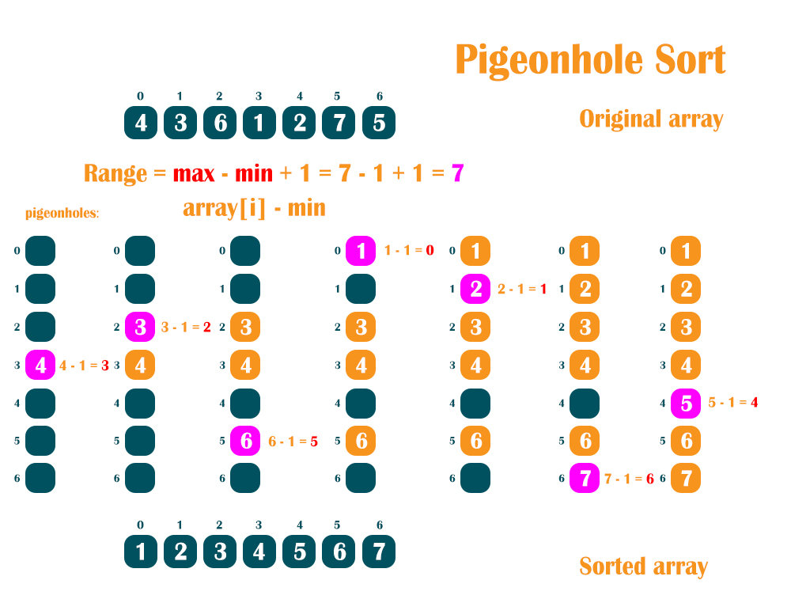
METHODOLOGY
International Conference on Emerging Technologies in Science and Engineering
Figure 1. Illustration of Pigeonhole Sort process
Observation: In pigeonhole sorting, before placing elements into pigeonholes, we calculate the range of pigeonholes using the formula :Range=max-min+1.
Each element is then placed into a specific pigeonhole determined by adjusting its value relative to min.(i.e, element-min).
AIT, TUMAKURU

Slide 6
SEQUENTIAL ALGORITHM
Step 1: Create Empty Pigeonholes:
Initialize an array of empty pigeonholes and return this array.
Step 2: Place Elements in Pigeonholes:
For each element in the input array, determine the pigeonhole index and append the element accordingly.
Step 3: Concatenate Pigeonholes:
Combine elements from all pigeonholes into a single array and return the concatenated array.
Step 4: Calculate Pigeonhole Index:
Calculate the index of the pigeonhole for a given element based on specific characteristics of the data. Return the calculated index.
Step 5: Pigeonhole Sort Function:
Execute the sorting algorithm by creating empty pigeonholes, distributing elements, and concatenating sorted elements into a final array.

Slide 7
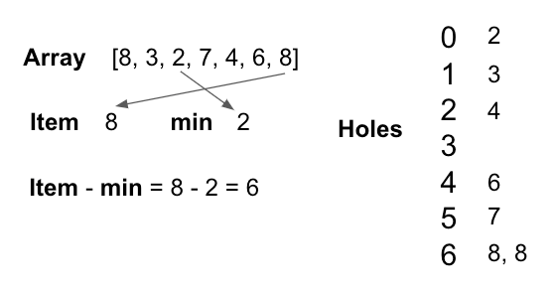
International Conference on Emerging Technologies in Science and Engineering
MPI Implementation Steps for Pigeonhole Sorting Algorithm:
Step 1: Initialization
During MPI initialization, each process is assigned a unique rank number.
Step 2: Distribution of Data
The input array is divided and scattered among all the processes.
Step 3: Local Sorting
Each process finds the minimum and maximum values within its array using the pigeonhole sort algorithm. Each process initializes a local pigeonhole array.
Step 4: Gathering Results
The root process gathers pigeonhole counts from all processes and reconstructs the sorted array.
Step 5: Finalization
The root process prints the final sorted array.
Figure 2. Illustration of Pigeonhole Sort Process for Parallel Approach
AIT, TUMAKURU

Slide 8
International Conference on Emerging Technologies in Science and Engineering
CUDA Implementation Steps for Pigeonhole Sorting Algorithm:
Step 1: Memory Management
Allocate memory for input data on both CPU-host and GPU-device. Transfer input data from host memory to device memory.
Step 2: Kernel Design and Launch Configuration
Create a CUDA kernel and configure blocks and threads per block based on data size for efficient processing.
Step 3: Kernel Implementation
Implement the sorting algorithm within the CUDA kernel, mapping elements to threads and managing blocks.
Step 4: Data Retrieval and Cleanup
Transfer sorted data from device memory back to host memory.
Step 5: Freeing Memory
Free allocated memory after sorting.
Figure 2. Illustration of Pigeonhole Sort Process for Parallel Approach
AIT, TUMAKURU

Slide 9
DATASET USED
Large Size: The dataset consists of over 100,000 randomly generated array elements numbers with a uniform distribution to test sorting algorithms' performance.

Slide 10
International Conference on Emerging Technologies in Science and Engineering
RESULTS
Table I. Execution Time and Speedup of Pigeonhole Sort Obtained from MPI and CUDA
Sl. No. | Sequential Execution Time (ms) | MPI Execution Time (ms) | Speedup achieved with MPI | CUDA Execution Time (ms) | Speedup achieved with CUDA
1 | 17.472 | 14.449 | 1.209 | 0.045 | 388.26
2 | 21.752 | 16.521 | 1.316 | 0.09 | 241.68
3 | 17.607 | 16.621 | 1.059 | 0.05 | 352.14
4 | 16.441 | 16.508 | 0.995 | 0.08 | 205.51
5 | 16.732 | 14.579 | 1.147 | 0.067 | 249.73
6 | 16.991 | 14.322 | 1.186 | 0.055 | 308.92
7 | 18.878 | 17.541 | 1.076 | 0.075 | 251.70
8 | 18.221 | 14.781 | 1.232 | 0.048 | 379.60
9 | 21.499 | 13.829 | 1.554 | 0.085 | 252.92
10 | 16.515 | 14.355 | 1.150 | 0.062 | 266.37
11 | 19.226 | 13.281 | 1.447 | 0.07 | 274.65
12 | 18.134 | 13.006 | 1.394 | 0.052 | 348.73
AVG | 18.289 | 14.98 | 1.231 | 0.065 | 293.36
The results were obtained by performing pigeonhole sorting sequentially, using MPI, and using CUDA over 12 different iterations, and the averages were calculated.
AIT, TUMAKURU

Slide 11
RESULTS AND ANALYSIS
Enhanced Efficiency: MPI and CUDA parallelization accelerate sorting by distributing tasks efficiently across processors and leveraging GPU capabilities.
CUDA Time Variability: Sorting times in CUDA can initially decrease but later vary between iterations due to factors such as memory access patterns and workload distribution among threads.
Time Variation and Optimization: Sorting times can vary in each CUDA and MPI iteration, prompting the need for adaptive strategies like task redistribution, on-the-fly partitioning, and performance prediction models to maintain consistent speedup.

Slide 12
CONCLUSION
International Conference on Emerging Technologies in Science and Engineering
This study aimed to enhance the efficiency of the Pigeonhole Sorting algorithm using MPI and CUDA for parallel processing. Both MPI and CUDA notably accelerate the algorithm compared to running it sequentially.
MPI enables collaboration among multiple computers to sort different data segments, efficiently handling large datasets by distributing tasks across machines.
CUDA's GPU acceleration significantly speeds up data processing, especially with large datasets, by performing multiple calculations simultaneously, outperforming CPUs alone.
AIT, TUMAKURU

Slide 13
REFERENCES
International Conference on Emerging Technologies in Science and Engineering
[1] Singh, D.P., Joshi, I. & Choudhary, J, “Survey of GPU Based Sorting Algorithms,” Int J Parallel Prog, vol. 46, pp. 1017–1034, 2018.
[2] Saxena, R., Jain, M., Sharma, D.P., “GPU-Based Parallelization of Topological Sorting,” Proceedings of First International Conference on Smart System, Innovations and Computing: SSIC 2017, pp. 411-421, Springer, Singapore 2018.
[3] Xiao, Shi-yang, Cai-lin Li, Bao-yun Guo, and Han Xiao, “A radix sorting parallel algorithm suitable for graphic processing unit computing,” Concurrency and Computation: Practice and Experience, vol. 33(6), e5818, 2021.
[4] Bozidar, Darko, and Tomaz Dobravec, “Comparison of parallel sorting algorithms,” Proceedings of the 2015 International Conference on Parallel and Distributed Systems, vol. 33, pp. 411-421, 2015.
[5] Faujdar, Neetu, and S. P. Ghrera, “Performance Analysis of Parallel Sorting Algorithms using GPU Computing,” International Journal of Computer Applications, vol.12(2), pp. 0975-8887, 2016.
[6] Díaz-Barrero, José Luis, “The Pigeonhole Principle,” Antoine Mhanna 23 The best constant in some geometric inequalities by Marius Dragan and Mihály Bencze 32, p.56, 2022.
[7] Jacquet, Baptiste, and Jean Baratgin, “The effect of cardinality in the pigeonhole principle,” Thinking and Reasoning, vol. 30(1), pp. 218-234, 2024.
[8] Yo'ldashev, Bilolkhon, and Sharobidinov Mukhriddin, “Investigating the Efficiency and Performance of Sorting and Searching Algorithms for Array Elements,” Science Promotion, vol. 1(1), pp. 31-34, Dec. 2023.
[9] Anaghashree, Sushmita Delcy Pereira, Rao B. Ashwath, Shwetha Rai , and N. Gopalakrishna Kini, “Super Sort Algorithm Using MPI and CUDA,” Intelligent Data Engineering and Analytics, Advances in Intelligent Systems and Computing (AISC), vol. 1177, pp. 165-170, Springer, Singapore, 2021.
[10] Harshit Yadav, Shraddha Naik, Ashwath Rao B, Shwetha Rai , and N. Gopalakrishna Kini, “Comparison of cutshort: A hybrid sorting technique using MPI and CUDA,” Evolution in Computational Intelligence, Advances in Intelligent Computing (AISC), vol. 1176, pp. 421-428, Springer, Singapore, 2021.
AIT, TUMAKURU

Slide 14
Thank you

